Slide 1


Final Project :
Examining scrapped data from Kijiji and Rentfaster using Spark and Yelp API [Partnership with Community Data Program]
Notes:
1

Slide 2

Team Members

Slide 3
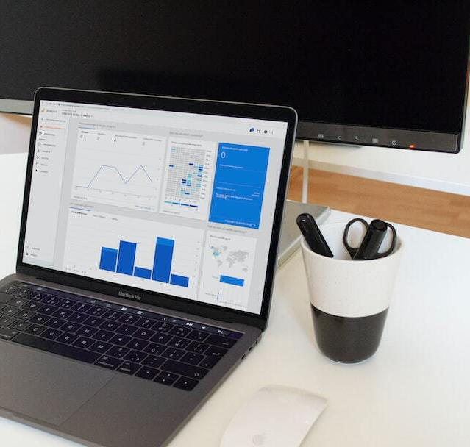
Introduction to Data Collection and Management
Project Overview: Introduction to the objectives of data collection and management for analyzing rental prices in relation to nearby restaurant quality/price.
Data Sources: Description of primary data sources used in the study, including web scraping and APIs from platforms like Yelp.
Scope of Analysis: Outline the scope of data analysis, including the geographic and temporal limits of the data collected.
Notes:
2

Slide 4
Issues in Data Acquisition
Blocked Requests: Common issue where web servers block scraping attempts, necessitating the use of proxies or other techniques to circumvent restrictions.
Dynamic Content Handling: Difficulty in scraping dynamically loaded content via JavaScript, requiring advanced parsing techniques like Selenium or Puppeteer.
Access and Legal Considerations: Challenges related to data access permissions and legal restrictions on web scraping activities.
Step 2
Step 1
Step 3
Goal
Notes:
5

Slide 5

Data Quality Issues
Identifying and Addressing Missing Values: Techniques used to handle missing data, including imputation methods and their impact on analysis accuracy.
Challenges with Mixed Data Types: Strategies to standardize data types across datasets to facilitate analysis, such as type conversions and categorical encoding.
Data Cleaning Techniques: Overview of data cleaning techniques employed, including outlier removal, normalization, and error correction to ensure data integrity.
Notes:
6

Slide 6
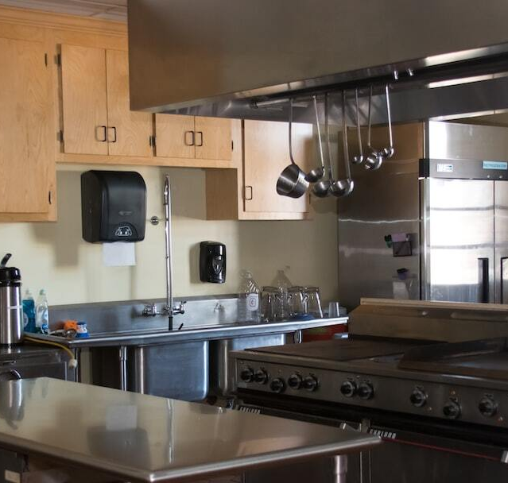
Data Analysis and Insights
Analysis Overview: Examination of the relationship between rental prices and the quality/price of nearby restaurants using data sourced from Yelp.
Statistical Methods: Utilization of regression models to identify potential correlations and assess significance of findings.
Key Insights: Summary of findings indicating whether there is a significant correlation between rental prices and the quality/price of nearby restaurants.
Notes:
7

Slide 7

Evaluation and Recommendations
Critical Evaluation: Assessment of current methodologies used in data analysis, pinpointing areas of improvement such as better data cleaning techniques or more robust statistical models.
Recommendations for Improvement: Suggestions for enhancing data acquisition, including diversifying data sources and implementing more advanced scraping techniques.
Suggestions for Future Analysis: Proposals for additional variables and models to consider for more comprehensive insights in future studies.
Notes:
8

Slide 8
Correlation Analysis - Rental Price vs. Restaurant Price
Hypothesis: Proposed correlation: higher rental prices are associated with higher-quality or higher-priced restaurants in the vicinity.
Analytical Approach: Employment of linear regression and correlation coefficients to explore the relationship between rental prices and nearby restaurant quality/price.
Findings: Preliminary results indicate a positive correlation, suggesting that areas with higher rental prices tend to have better quality or more expensive restaurants nearby. Detailed statistical analysis to follow for precise quantification.
Notes:
10

Slide 9

Yelp Data Quality Evaluation
Data Completeness: Evaluation of the completeness of Yelp data, including coverage of restaurant types, geographic distribution, and update frequency.
Accuracy and Reliability: Analysis of user review mechanisms and their reliability. Consideration of the verification processes for user-submitted content on Yelp.
Insights Driven by Yelp Data: Assessment of how well Yelp data supports the study of correlations such as rental prices to restaurant quality/price. Discussion of limitations and potential biases in Yelp reviews.

Slide 10
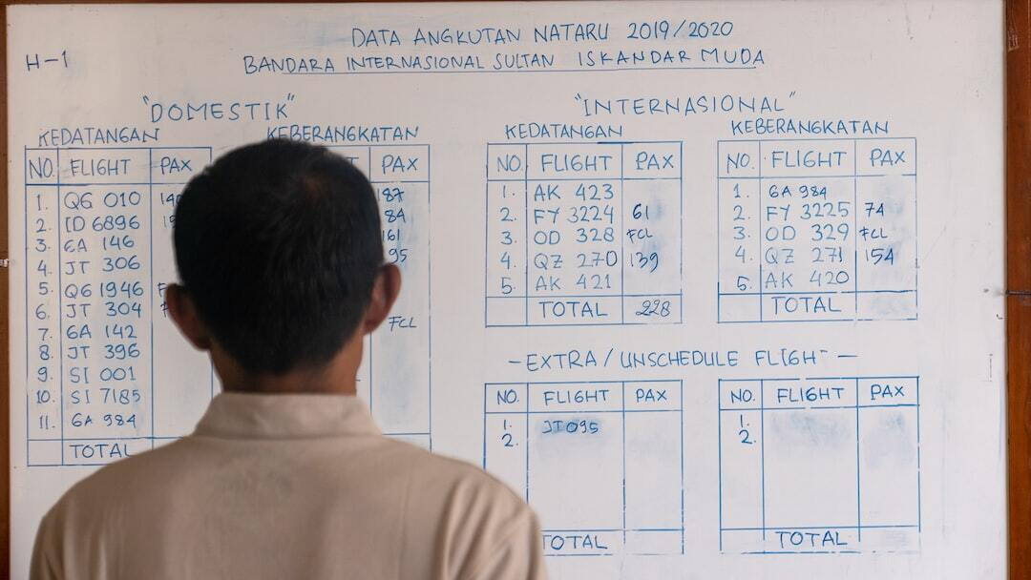
Improving Data Analysis for Conclusive Results
Advanced Analytical Techniques: Integrate more sophisticated statistical methods and machine learning algorithms to improve predictive accuracy and insight depth.
Diverse Data Sources: Incorporate additional data sources to provide a more comprehensive view and mitigate biases inherent in single-source data.
Real-time Data Integration: Utilize real-time data feeds to enhance the dynamic understanding of trends and improve the responsiveness of the analysis.

Slide 11
Scalability Assessment of Data Pipeline
Current Infrastructure Review: Examination of the current data pipeline infrastructure, evaluating its ability to manage, process, and analyze big data efficiently.
Scalability Analysis: Detailed analysis of scalability aspects, including data ingestion rates, processing capabilities, and real-time data handling.
Recommendations for Enhancement: Strategic recommendations to enhance the data pipeline's scalability, focusing on modular architecture, cloud solutions, and advanced data processing technologies.

Slide 12
Future Directions
1. Next Steps in Analysis: Plan for integrating additional data sources and employing more sophisticated analytics techniques to improve the comprehensiveness of insights.
2. Considerations for Scaling: Exploration of technologies and infrastructure improvements necessary to scale the data pipeline for handling larger datasets effectively.
3. Long-term Goals: Setting long-term goals for continuous improvement of data collection and analysis processes, focusing on automation and real-time data processing.
Notes:
9

Slide 13
Thanku

